Slide 1

RESEARCH PROJECT · SEMESTER 7
UPI FRAUD
RADAR
Anomaly detection and behavioural pattern mining using integrated machine learning pipelines.
PROJECT GROUP MEMBERS
FULL NAME
ENROLLMENT NO.
ROLL NO.
Jiya Chhatbar
23004500210041
E-27
Darshana Rangoliya
23004500210049
D-06
Faiz Badi
23004500210015
B-05
L.J. School of Computer Application
Under the Guidance of Prof. Swati D. Londhe

Slide 2

01
1. INTRODUCTION
PROJECT OVERVIEW
1.1 ABSTRACT
1.2 PROJECT PROFILE
1.3 PROBLEM STATEMENT
UPI Fraud Radar is a comprehensive Machine Learning pipeline designed to secure real-time digital payments. It translates high-velocity transaction streams into actionable fraud probabilities, risky user segments, and interpretable behavioural rules.
Domain
ML · FinTech · Fraud Analytics
Extreme Volume
Instant UPI transfers leave zero room for manual verification.
Learning Models
Classification, Clustering, Rules
Skewed Data
Fraud represents only ~0.13% of transactions.
Deployment
Interactive Streamlit Dashboard
Tactical Evolution
Dynamic fraud patterns require adaptive, explainable ML.
Project logic re-authored for clarity based on original documentation.
02 / 12

Slide 3

02
2. ORGANIZATION OF DATA
DATA ARCHITECTURE
2.1 DATA SOURCE
2.4 DATA VOLUME
Utilizes the PaySim Synthetic Financial Dataset (Kaggle). Real mobile-money logs are transformed into a UPI-analogue environment via custom behavioral engineering.
6.36M
8,213
743
RECORDS
FRAUD CASES
HOURLY STEPS
2.2 DATA CATEGORY
2.3 DATA DESCRIPTION
Structured Transaction CSV
Supervised Target Label
11 base columns (Type, Amount, Balances, IDs) extended by hour, night-time, balance-diff, and account-emptied indicators for improved detection.
Behavioural Engineered Data
Clustering & Rules Logs
Dataset metrics confirmed from project documentation Section 2.
03 / 12

Slide 4

02
2. ORGANIZATION OF DATA / SUMMARY + TOOLKIT
READY FOR MODELLING
2.5 DATA SUMMARY
2.6 TOOLS AND TECHNIQUES
The dataset is large, labelled, and extremely skewed. Fraud appears only in TRANSFER and CASH_OUT flows, which makes both feature design and evaluation discipline essential.
Python + pandas
scikit-learn
Cleaning, joins, feature tables
Classification + evaluation
imbalanced-learn
mlxtend
SMOTE and class weights
Apriori rule mining
Mean amount
₹179,861.90
Median amount
₹74,871.94
Matplotlib
Streamlit + joblib
EDA and diagnostic plots
Interactive deployment
Maximum amount
₹92,445,516.64
Fraud share
≈ 0.13%
Design principle: optimize for Recall, Precision, F1-score, and PR-AUC—not headline accuracy.
Missing values
None reported
Project stack reconstructed from the attached documentation.
04 / 12

Slide 5

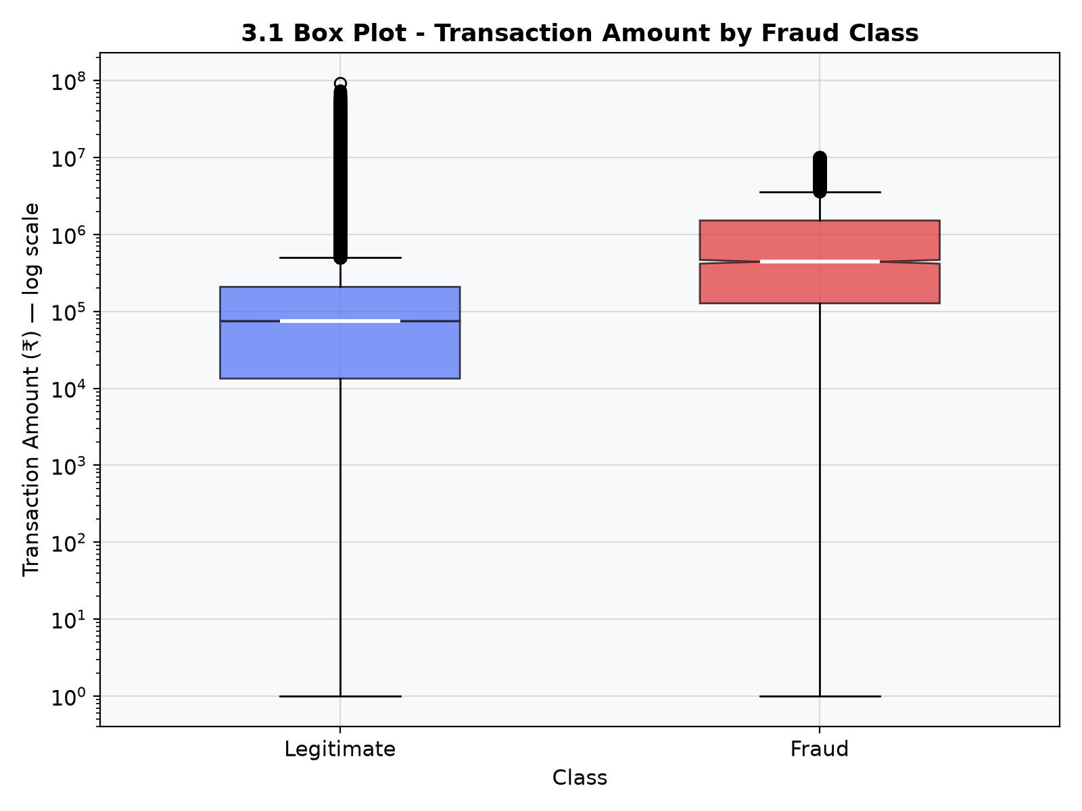
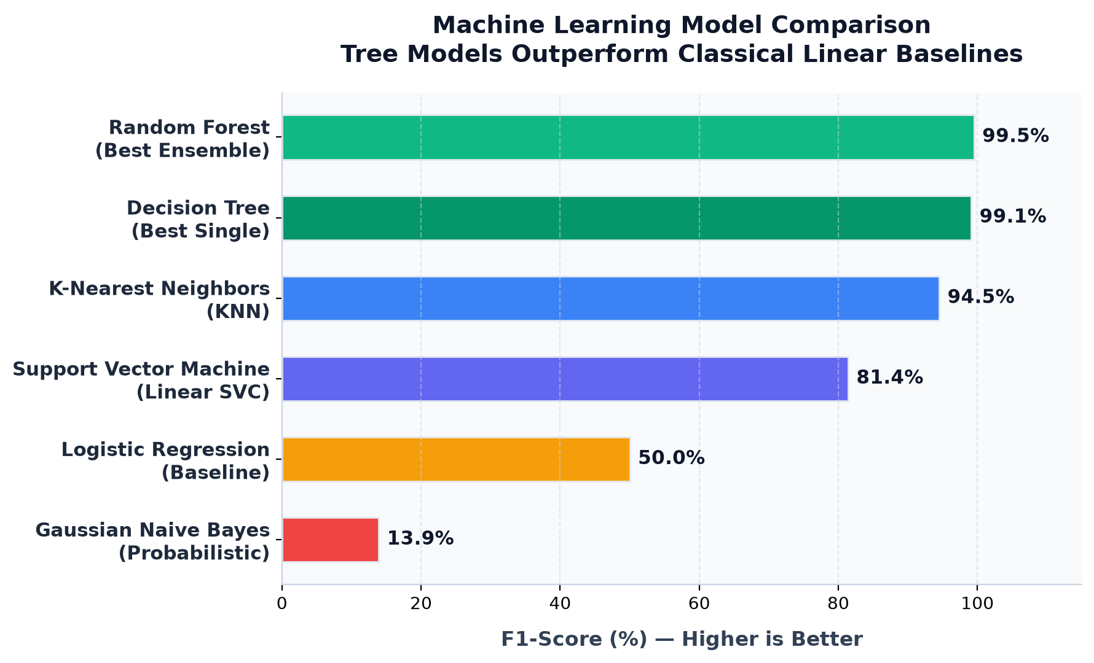
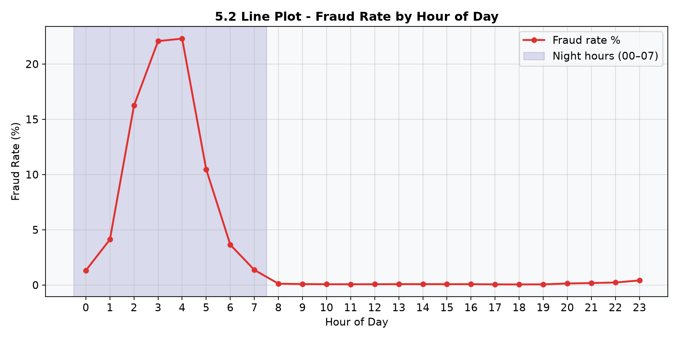
03
3. DATA VISUALIZATION / ORIGINAL DATA
EXPLORATORY ANALYSIS
3.1 BOX PLOT
3.2 HIST PLOT
3.3 LINE PLOT
Transaction amount by class (Log scale). Fraud cases show significantly higher median and extreme outliers.
Overlapping distributions reveal that high-value segments are disproportionately fraudulent.
Transaction volume by hour (Step mod 24). Activity peaks during business hours and falls late night.
Insights from Evidence: Amount distributions and temporal patterns are primary discriminators for detecting anomalous digital payment behaviour.
05 / 12

Slide 6

04
4. DATA CLEANING
MODEL-READY DATA
4.1 DATA SUMMARY · WHAT CHANGED
QUALITY CHECKPOINT
01
Validate
Null records
0 reported
Check types, duplicates, and missing values. PaySim reports no missing values.
Split strategy
80 : 20 stratified
02
Keep meaningful extremes
Outliers in amount are retained because extreme value is itself a possible fraud signal.
Imbalance handling
SMOTE + class weights
03
Reduce noise
Feature selection
SelectKBest + RF importance
Drop high-cardinality nameOrig/nameDest; one-hot encode transaction type.
Fraud ratio
Preserved realistically
04
Engineer behaviour
hour, isNight, sender/receiver balance difference, and origEmptied.
The result is not a “cleaned-away” fraud problem. The pipeline preserves rare-event structure while making the variables learnable.
05
Prevent leakage
Fit scaling, feature selection, and SMOTE only on the training split.
Cleaning decisions reconstructed from Sections 4 and 2.6 of the documentation.
06 / 12

Slide 7

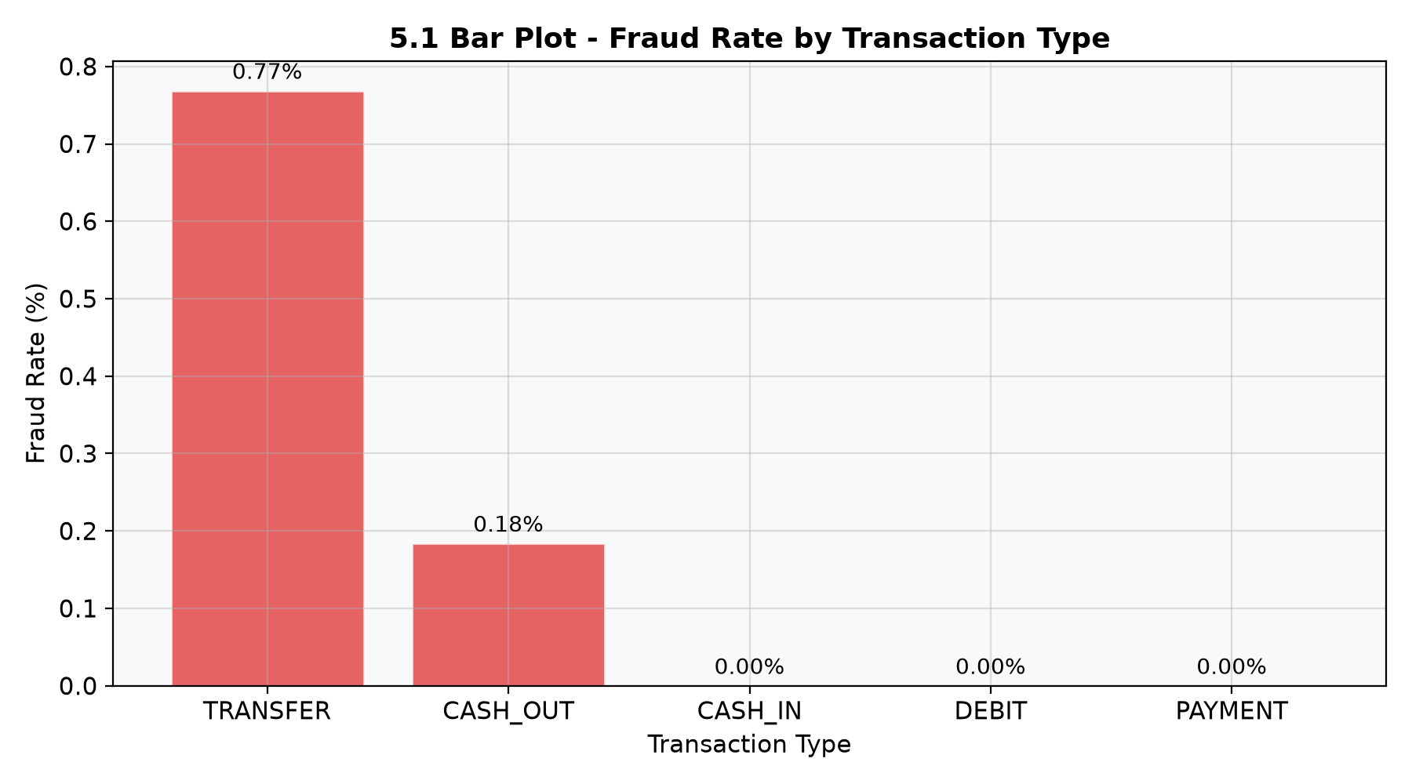
05
5. DATA VISUALIZATION / SIGNAL ANALYSIS
DESCRIPTIVE RESULTS
5.1 FRAUD CONCENTRATION
5.4 HYPOTHESIS FORMATION
H1 · Time Risk
Late-night transaction velocity (00:00–07:59) correlates with an elevated fraud probability.
H2 · Type Anchor
Fraud signals are isolated exclusively in Transfer and Cash-Out payment streams.
H3 · Balance Sweep
Attempts to fully deplete sender accounts act as a primary behavioral red-flag.
Fraud Rate by Transaction Type (%)
Analysis confirms that fraud is structured and behavioral, not random.
07 / 13

Slide 8

06
6. MODELING / IDENTIFICATION
MODEL ROSTER
TECHNIQUE
ROLE
WHY IT MATTERS
FAMILY
Logistic Regression
Baseline probability
Reference point for fraud likelihood
Supervised
Decision Tree / Random Forest
Rules + ensemble
Interpretability and feature importance
Supervised
KNN / SVM / Naive Bayes
Alternative classifiers
Distance, margin, and probabilistic views
Supervised
MLP Neural Network
Non-linear learner
Tests ReLU, Sigmoid, and Tanh representations
Supervised
K-Means / K-Medoids / Hierarchical
Risk segmentation
Groups users into behavioural clusters
Unsupervised
Apriori
Pattern mining
Finds support-confidence-lift fraud rules
Rules
Selection lens
Evaluation lens
Reliability lens
High recall with acceptable precision—not accuracy theatre.
Precision, Recall, F1-score, PR-AUC, confusion matrix.
Stratified 5-fold CV plus bootstrap confidence intervals.
Model roster and purpose adapted from Section 6.1 of the documentation.
08 / 12

Slide 9

06
6. MODELING / IMPLEMENTATION
PIPELINE ARCHITECTURE
1 · Load + Split
2 · Prep + Scale
3 · Cross-Val
4 · Cluster + Rules
5 · Deployment
PaySim processing; stratified 80:20 training/test sets.
SMOTE, class weights, and behavioral engineering.
5-fold stratified CV with bootstrap confidence intervals.
K-Means segmentation and Apriori pattern mining.
Pickled model served via an interactive Streamlit UI.
DECISION OUTPUT
CORE IMPLEMENTATION STRENGTH
System generates a fraud probability, a categorized risk level, and clear top reasons for analyst review.
Combines supervised accuracy with unsupervised behavioral grouping for a 360° risk view.
Explainable Prediction
Integrated Defense
Reconstructed from Section 6.2 of the project documentation.
09 / 12

Slide 10

07
7. DISCUSSION AND CONCLUSION
FINAL VERDICT
DISCUSSION
CONCLUSION
Pattern Density
System Validation
Fraud is heavily clustered in specific transaction flows, making isolation possible.
The project proves that imbalance-aware ML pipelines can effectively safeguard digital payments by merging prediction with behavioral discovery.
Temporal Windows
The night-time flag acts as a critical risk multiplier in the final model.
Boundary: system should be retrained on live NPCI feeds before production scale-up.
Rule Interpretability
Mining rules ensures that decisions are not just accurate, but also explainable.
Conclusion distilled from project report Section 7.
10 / 12

Slide 11
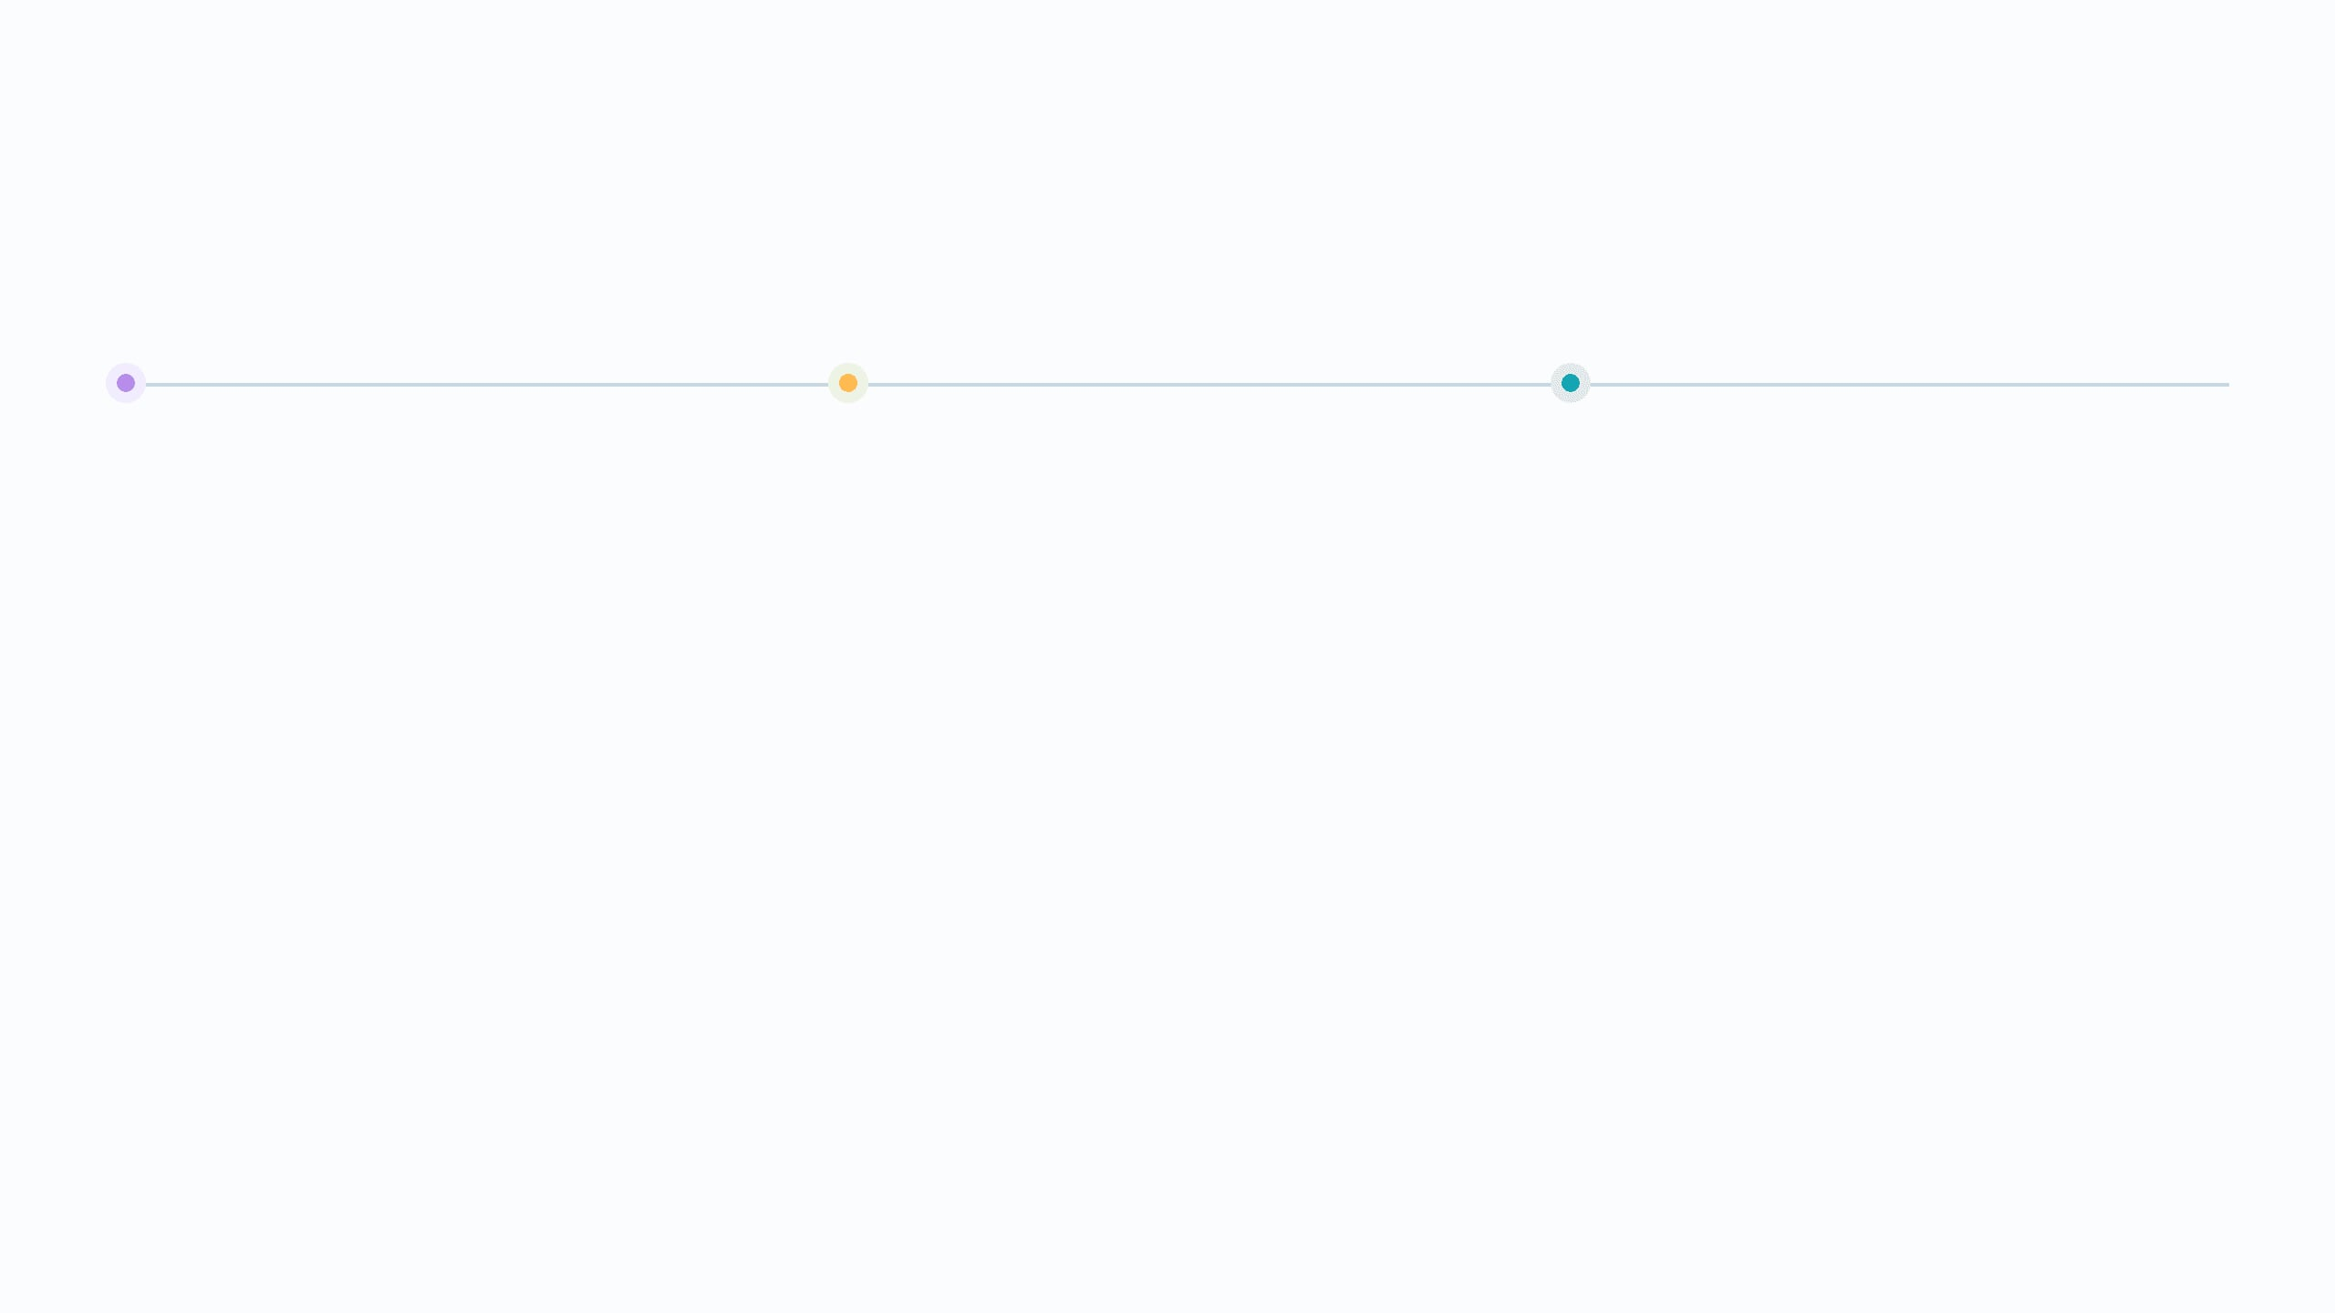
08
8. FUTURE DIRECTION
NEXT ITERATION
01 · Real data validation
02 · Streaming detection
03 · Deeper intelligence
Move from PaySim to controlled bank/NPCI transaction data and re-check calibration, fairness, and drift.
Introduce Kafka or a similar event layer so risk scores can be generated continuously instead of batch-only.
Add LSTM/autoencoders for sequences, graph analysis for fraud rings, SHAP/LIME explanations, and alert-to-OTP workflows.
A stronger fraud radar will not only predict the next risky transaction—it will learn how the network around that transaction behaves.
Roadmap distilled from the attached documentation’s Section 8.
11 / 12

Slide 12

09
9. BIBLIOGRAPHY
REFERENCES
Lopez-Rojas, E., et al. (2016)
PaySim Financial Dataset
“PaySim: A financial mobile money simulator for fraud detection.” 28th EMSS.
Synthetic UPI-analogue logs via Kaggle Repository.
Pedregosa, F., et al. (2011)
Chawla, N. V., et al. (2002)
“Scikit-learn: Machine Learning in Python.” JMLR.
“SMOTE: Synthetic Minority Over-sampling Technique.” JAIR.
Breiman, L. (2001)
mlxtend Library
“Random Forests.” Machine Learning, 45(1).
Open-source toolset for Association Rule Mining (Apriori).
All sources verified against the project documentation bibliography.
12 / 13

Slide 13

PROJECT COMPLETE
THANK
YOU.
| PROJECT TEAM |
Jiya Chhatbar
Darshana Rangoliya
Faiz Badi
L.J. SCHOOL OF COMPUTER APPLICATION · SEMESTER 7
13 / 13

